Slide 1

Fictional Dice Business

Slide 2
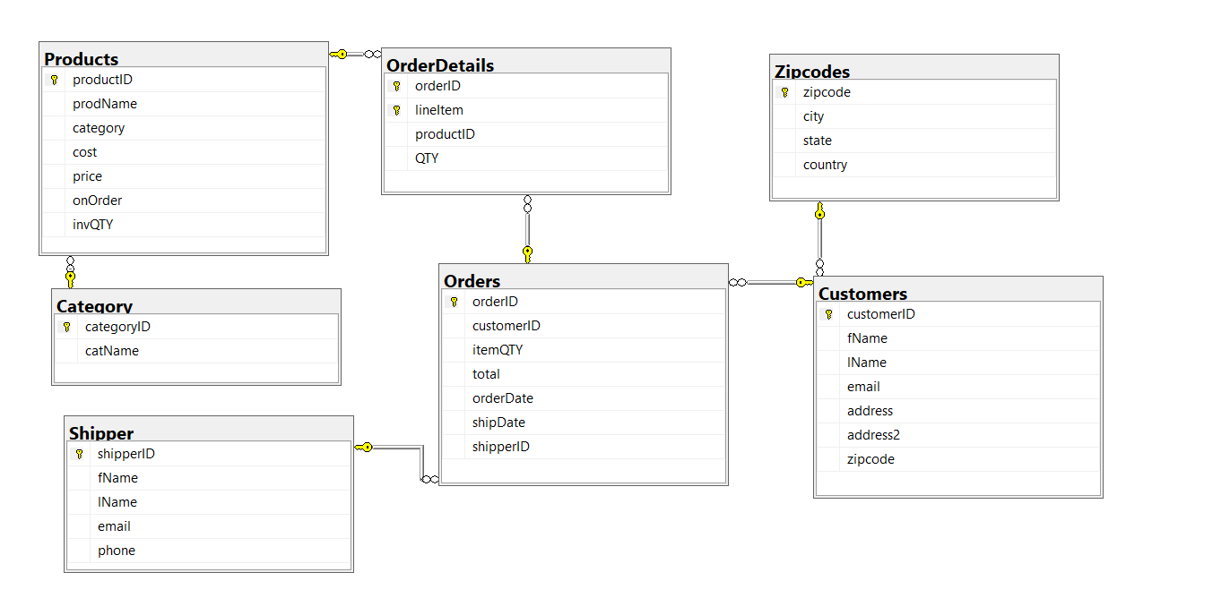
Database Diagram

Slide 3
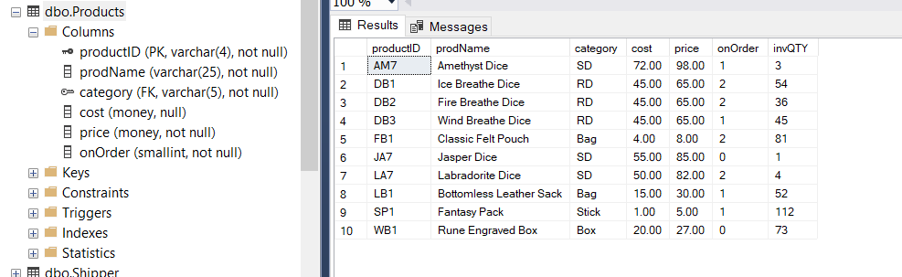
Products Table

Slide 4
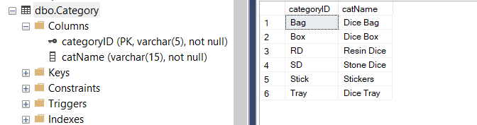
Product Categories Table

Slide 5
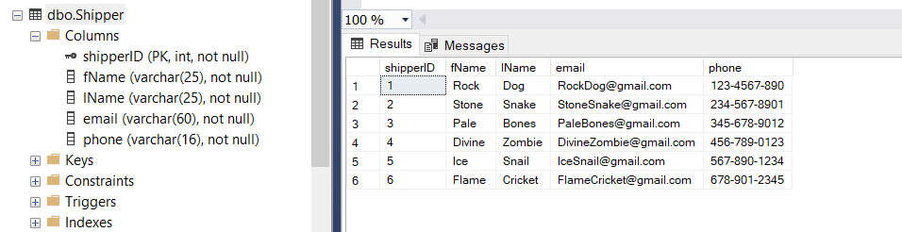
Shippers Table

Slide 6
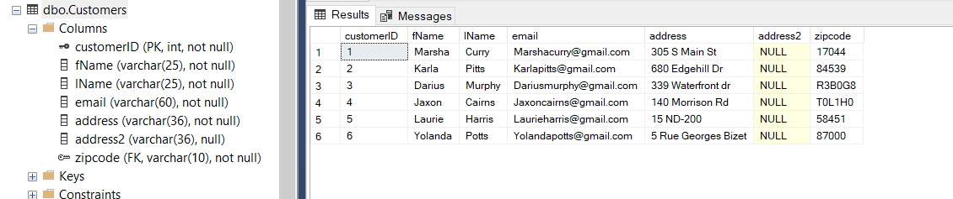
Customers Table

Slide 7
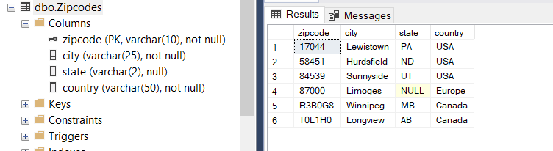
Zipcodes Table

Slide 8
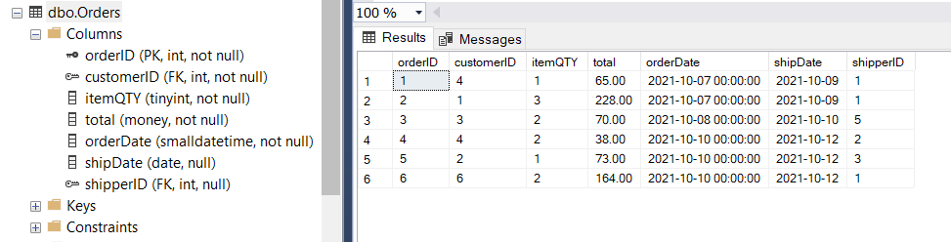
Orders Table

Slide 9
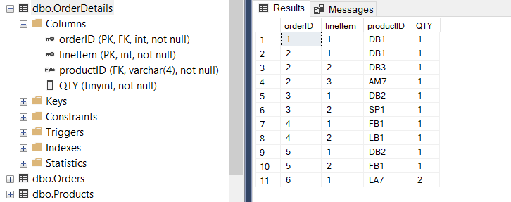
Order Details Table

Slide 10
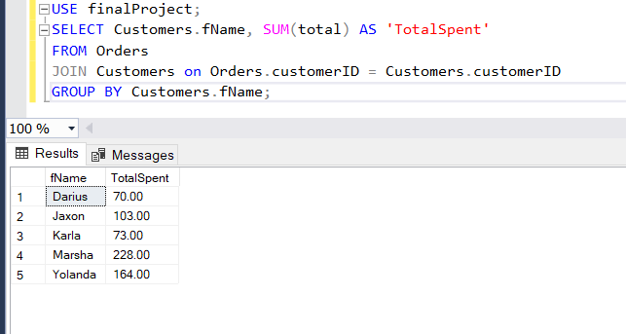
Summary Query
Shows the total amount every customer has spent, useful if you want to give back to your best customers.

Slide 11
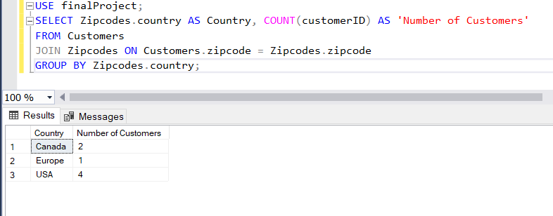
Summary Query
Shows the countries your customers are from, with this information you may change how you advertise or market your product.

Slide 12
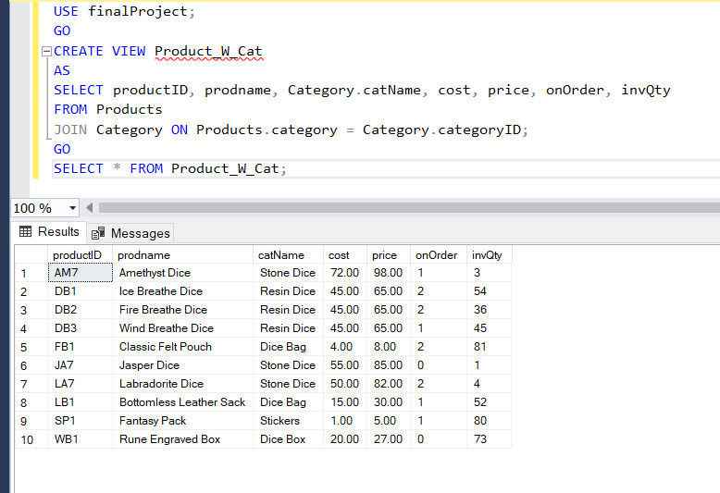
View
Shows the products table with the full category name rather than just the abbreviation

Slide 13
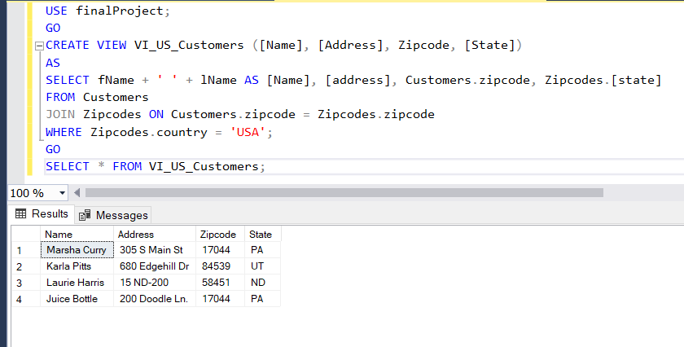
View
Only shows customers from the US.

Slide 14
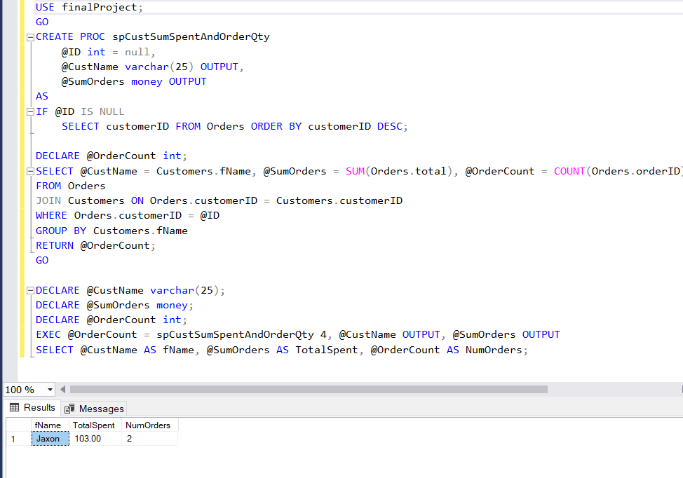
Stored Proc
Uses customer ID to pull their name, total spent, and total number of orders.

Slide 15
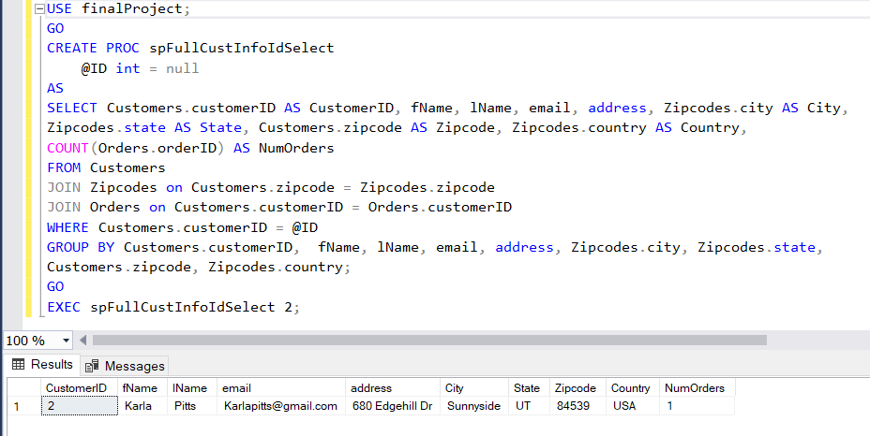
Stored Proc
Combines the Zipcode and Customer table. And adds up that customers order quantity.

Slide 16
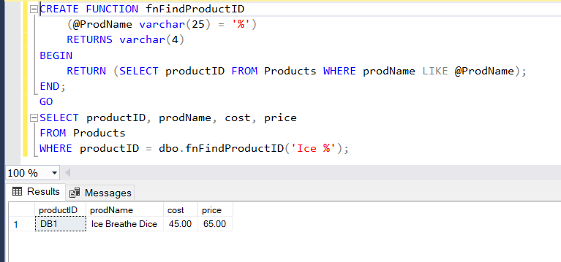
Function
Finds the product ID based off partial product description.

Slide 17
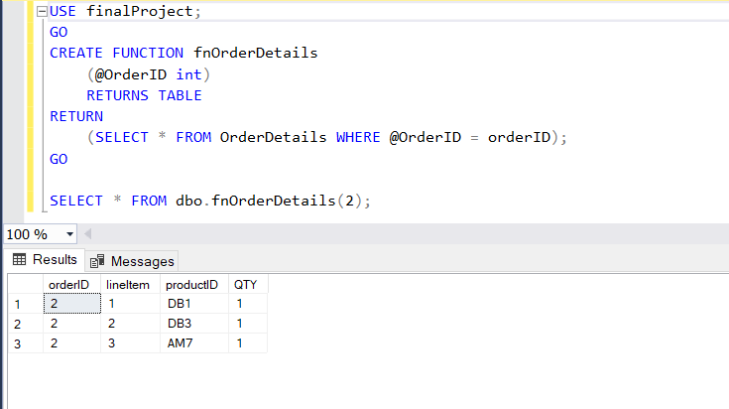
Function
Table function that gives all the lineitems for a specific orderID.

Slide 18
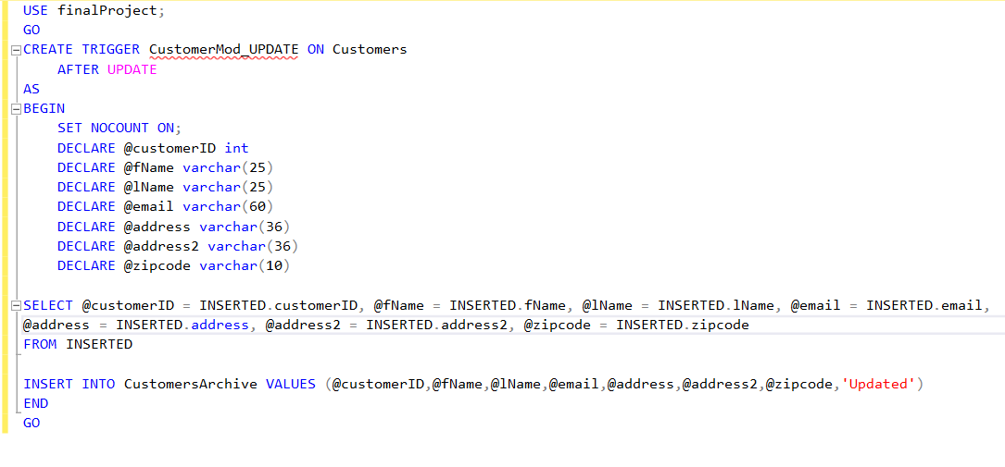
Trigger
When the Customer table is updated, it sends a record into the CustomerArchive table so it is easy to track changes

Slide 19
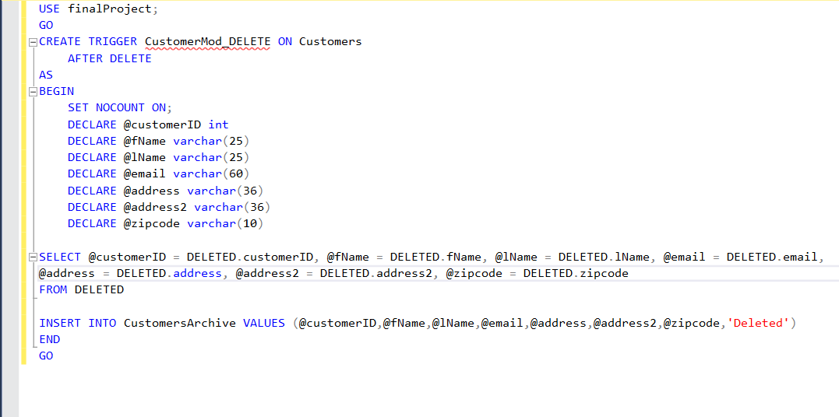
Trigger
When the Customer table has a deletion a record is sent to the CustomersArchive table.

Slide 20
What Went Well
Problems
There are a ton of fun ways to use summary queries!
Creating stored procedures and functions was fun and I can see how useful they can be for people who might not know their way around the database or are limited in what they can view.
Inputting data is very time consuming, in certain situations I felt like I could have put together more useful queries if I had more time to add fake data.

Slide 21
What I Learned
What To Add Next
Learning about the structure of databases and how to navigate them really opened my eyes to the hidden side of the internet and how everything fits together.
I now realize how often databases need to updated and modified to accommodate changes or growth.
I would want to add table for different sales outlets besides the company website, and maybe a table for a rewards system.

